Slide 1
Camera Nano: Pedestrian Detection Team Project Demo
Bharath Ramachandraiah
Nicolas Ojeda Leon
Sameera B Chilmattur
Sandeep Raju
IMSEIT, H-DA
22-July-2019

Slide 2
Agenda
What
How
What – in much detail
What next?

Slide 3
Project Goals
Pedestrian Detection Hardware Platform with Future Focus
Single Pedestrian Detection – A step in the door approach
Scalable Thread based Development
Non-Intrusive Feature Addition to Existing Platforms
Common Interfacing

Slide 4
Prepare Phase Accomplishments
Study of Algorithms
Analysis of Hardware Platforms
Redefining of Goals
Effort Estimation, Expert Review

Slide 5

Prepare Phase Accomplishments
Risk Management
Hardware Platform – cost vs performance vs ease
ease of development vs future scope
Features – Usage of Camera Data, Usage of
LiDAR data, Sensor Fusion
Hardware Availability – NVIDIA launch
Risk Mitigation
Choice of RPI-3 as development vehicle
VirtualBox Linux for development and trials
De-scoping Sensor Fusion and Aurix Data Consumption tasks
Planning “Car” dependency to the end of the project

Slide 6
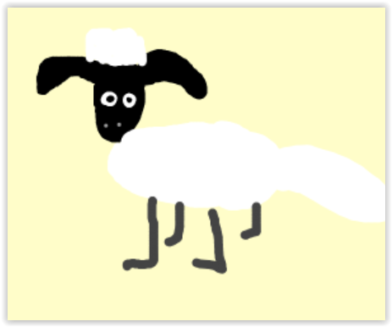
Produce Phase Practices – Skinny Sheep Model with Blue Sky Thinking
Start small
Every team member had VirtualBox development platform with common goals
Everyone tried doing things differently in the initial phase
Technical discussion sessions helped bring ideas together

Slide 7
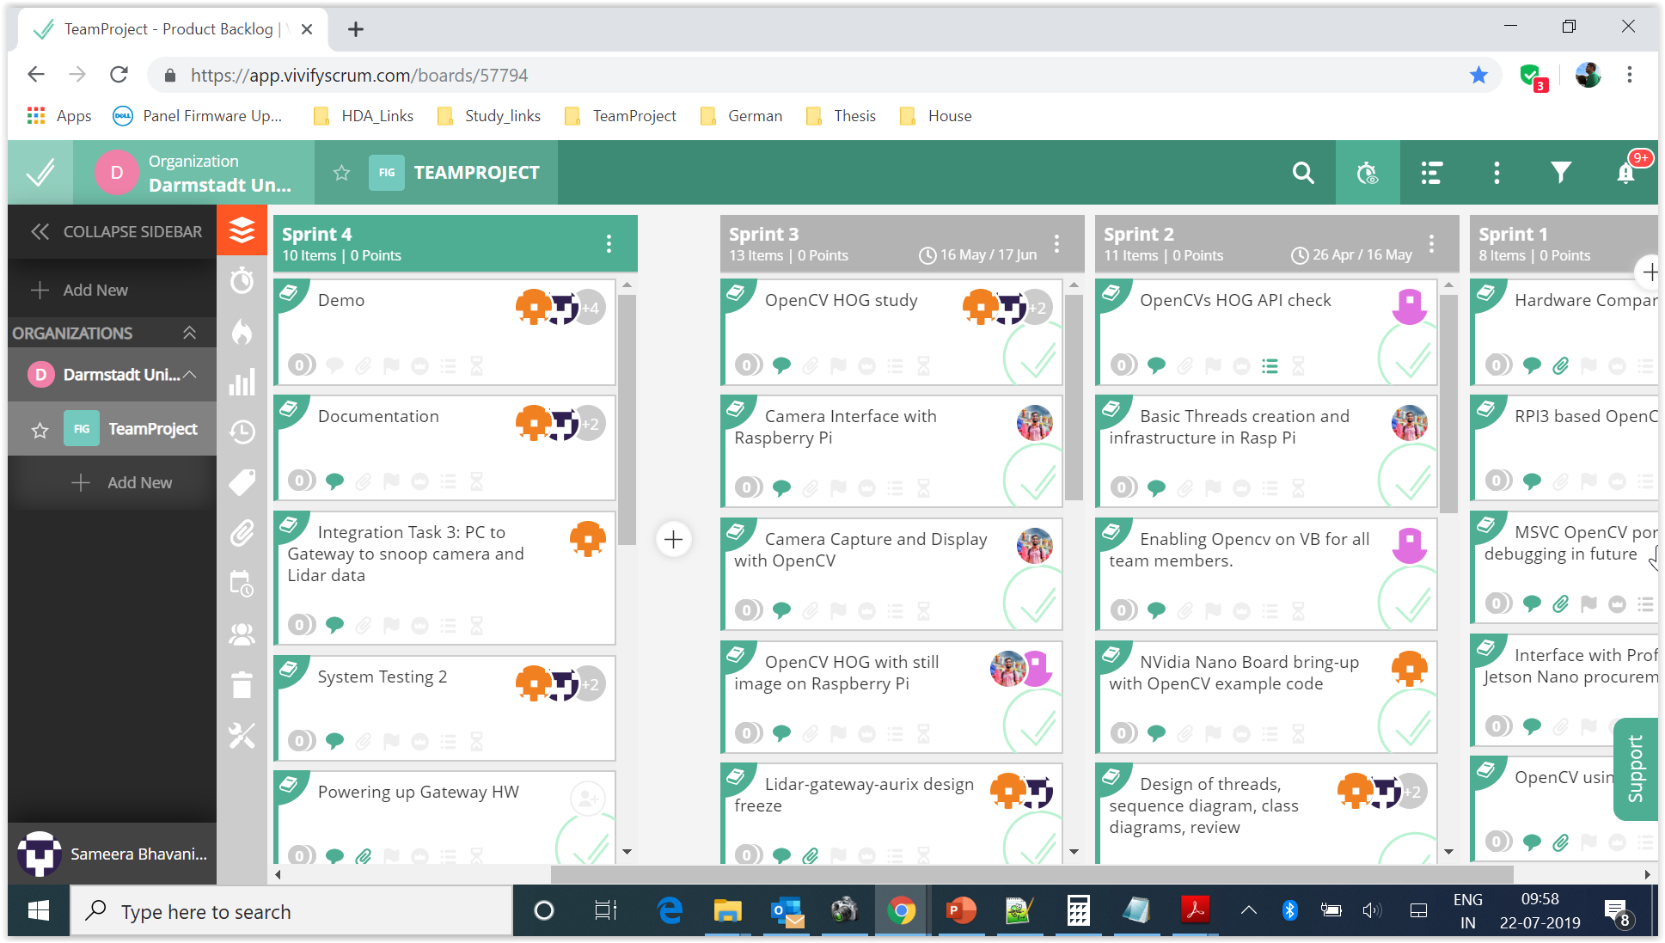
Produce Phase Practices – Agile Process

Slide 8
Produce Phase Practices
Meetings
Sprint Planning, Daily Stand-up
Weekly Status Review Meetings
Reviews
Expert Reviews for Interface Design
2-Eye review and development
Testing
Unit Testing
System Testing

Slide 9
Budget
Effort:
Overall 1000 Hours spent
About 30% of the time spent in Testing and fine tuning
About 30% of the time spent in the Prepare phase for Concept, Design and Architecture
About 25% time spent in Coding and Debugging
About 5% time spent in Rework due to Change Requests, Reviews and Bugs
Cost:
Close to 1000 Euros spent on hardware and consumables – approved by Customer

Slide 10
Component Interface Design Design Goals and Initial idea
Design Goals
Common interface between CameraNano and Maze team projects
Modular and service-based implementation of features
New hardware connected to car should be through CAN interface
Initial idea
LiDAR detecting obstacle and requests Nano to check if it is pedestrian
Reduces overall power consumption
Increases load on PSoC
Not modular and not scalable

Slide 11
Component Interface Design Final design
LiDAR
CAN
Gateway
UART
Camera-Nano
Common interface for both CameraNano and MAZE camera's
More features can be added in AURIX app / Nano in future
No design impact for camera change and multiple cameras addition
CAN
AntiCollision
UART
CAN
AURIX

Slide 12
Component Description: LiDAR
Functionality
Acts as additional check for pedestrian detection mechanism
AURIX can query detection data via CAN and take decisions
Implementation
Implemented as separate service and not along with anti-collision
The detection service is called cyclically by RTOS
The service provides obstacle distance and angle in relevant ROI
Send this info to Gateway as response to SDO request

Slide 13
Component Description: LiDAR
System Testing
Simulating AURIX query through PCAN viewer to Gateway
Gateway sends SDO requesting data to LiDAR
LiDAR responds to request with latest scan-based detection info
Gateway forwards results to AURIX (simulated via PCAN viewer)
Future scope of work
More robust algorithms to detect human can be run on LiDAR data
Multiple objects detected and their widths can be sent

Slide 14
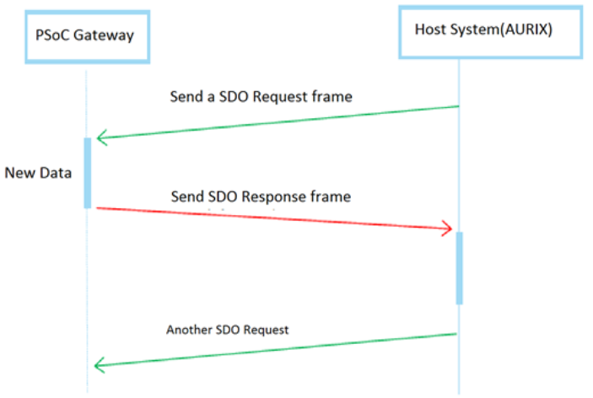
Component Description: Gateway
Functionality
Primary interface to AURIX for Camera and LIDAR data retrieval
Acts as both CANOpen Client and Server
Periodically recieve and maintain latest camera and LiDAR data
Supports separate CANOpen indices for Camera and LiDAR data query

Slide 15
Component Description: Gateway
Implementation
Common code framework across student car projects
Data managed by Gateway -
LiDAR Data: distance and angle of obstacle
Camera Data: angle and width of pedestrian detected
Challenges faced
CANOpen SDO request for LiDAR data fails after few attempts
root-cause: SDO dispatcher full due to non-deletion of entries
solution: periodic call of CANopen_Client_Tick()
System Testing
Simulating AURIX query for LiDAR data and Camera data through PCAN and verify through manual inspection and in PCAN

Slide 16
Component Description: CameraNano Application
Nvidia Jetson Nano
Quad Core ARM Cortex A57 at 1.43GHz
4GB LPDDR4
128 core Maxwell GPU
Upto 8 Camera connections
Latest Linux LTS Distribution - Ubuntu
OpenCV optimized for the hardware

Slide 17
Component Description: CameraNano Application
Functionality
Detects any Pedestrian in the Camera’s FOV
Nano obtains camera scans at 30 FPS
Runs OpenCV-HOG based detection Algorithms
Filter the false positives
Compute the angle of location of the Pedestrian from Pixel value
Delta angle of the Pedestrian
0⁰
Theta
Delta Theta

Slide 18
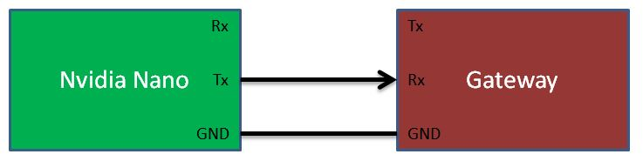
Component Description: CameraNano Application
Interface to the system
NVidia board is connected to Gateway via UART
Transmits the detected information
Theta
Delta Theta

Slide 19
Component Description: CameraNano Application
Implementation
Single process - 5 threads application
Detection
Camera Service
Communication Tx Service
Communication Rx Service
Background
MailBoxes
Resources
Camera
UART
Mutex, Semaphore

Slide 20
Component Description: CameraNano Application
Challenges faced
Setting up the gstreamer with relevant configurations for Camera
Configure camera – Orientations, resolutions, etc.
Multi-threaded application in C++
Required power for the board

Slide 21
Component Description: CameraNano Application
Unit testing
Robust Camera and UART testing
Detection on sample still photos and videos
Calculations of Theta and Delta Theta for different positions
Systems Testing
Subjects at different positions – Verified in the monitor
Captured positions – Green boxes and Values printed

Slide 22
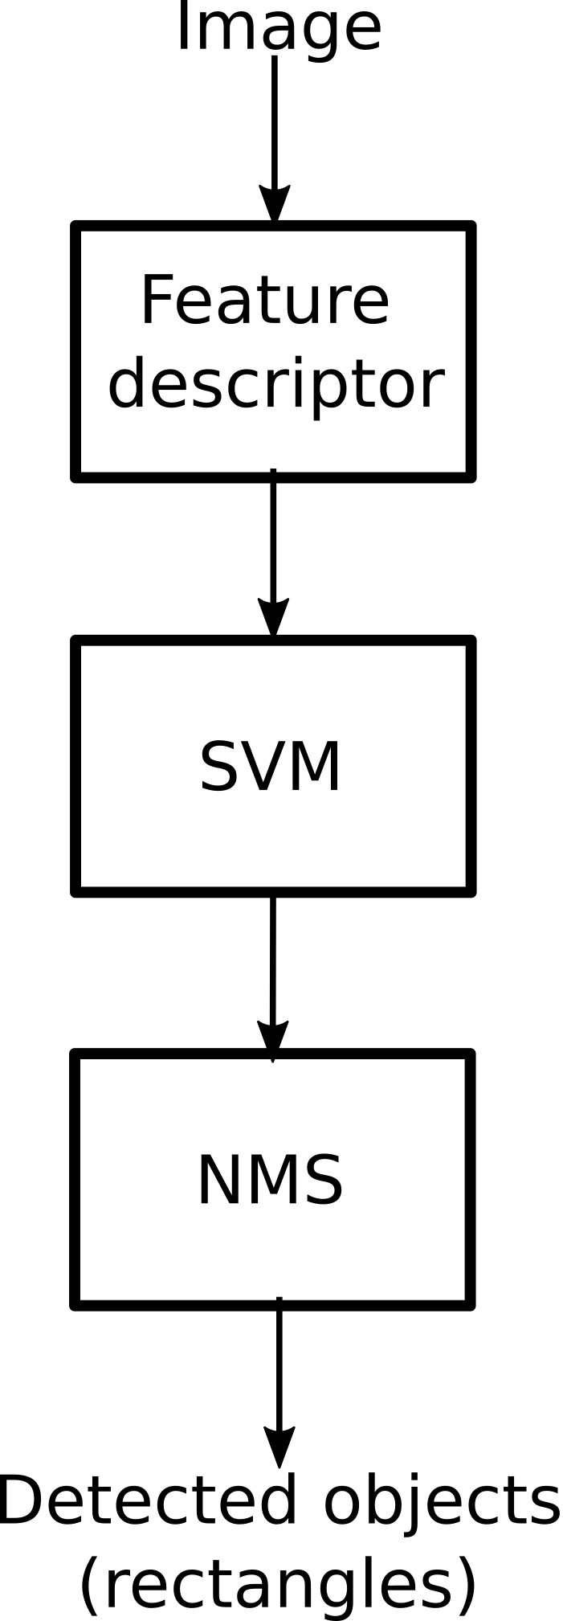
Component Description: CameraNano Algorithm
Feature descriptor (HOG)
Useful to stand out edges - Shape information
Normalization to reduce illumination and contrast differences.
Pixel patches for compact information and noise immunity.
Single numerical vector output
Support Vector Machine (SVM)
Trained decision model
Non maximum suppression (NMS)
Merging several overlapping detections

Slide 23
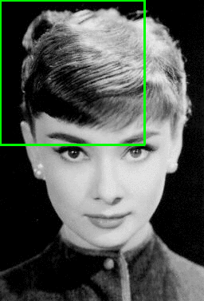
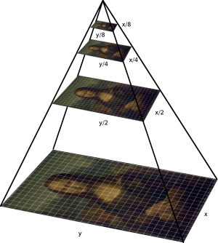
Pedestrian detection
Starting with the image’s original size, place the window in the top left corner and run the algorithm.
Slide the window (winStride pixels), and run the HOG on the next segment.
For each HOG, make a decision if the window contains a person
Scale the image (by scale factor) and start again
source: Rosebrock. pyimagesearch. [5]

Slide 24
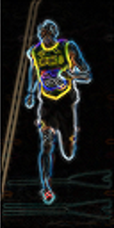
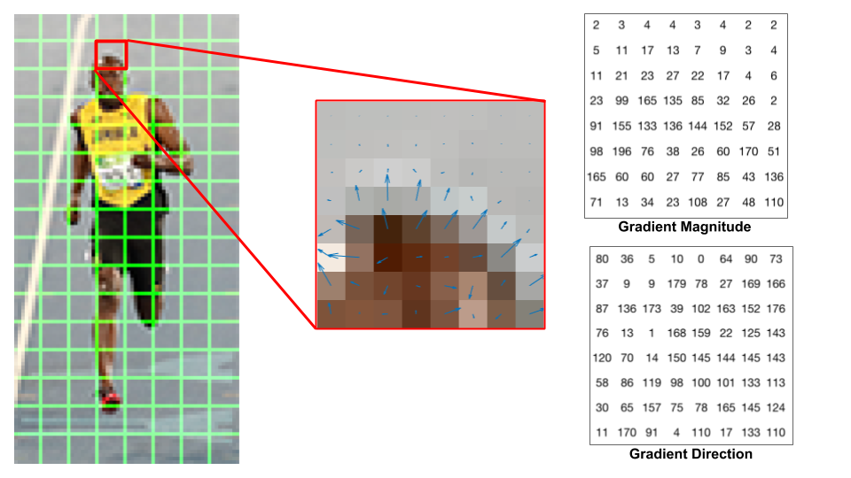
Feature descriptor (HOG)
Segment the image in patches (64x128)
Calculate the gradient (magnitude and angle)
Divide the patch in 8x8 cells
64
128
source: Mallick. learn OpenCV. [2]
source: Mallick. learn OpenCV. [2]

Slide 25
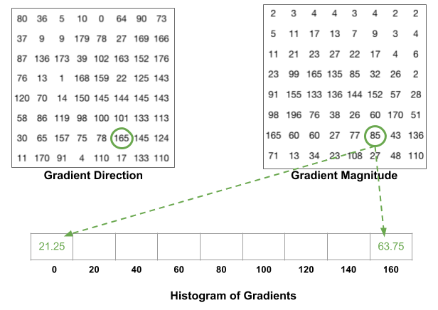
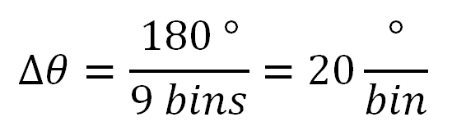
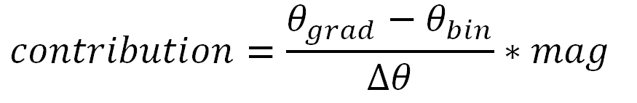
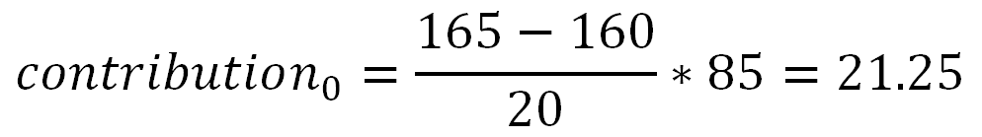
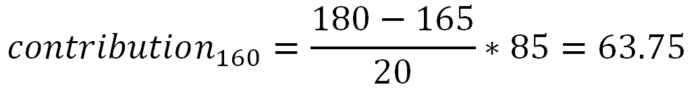
Feature descriptor (HOG)
Segment the image in patches (64x128)
Calculate the gradient (magnitude and angle)
Divide the patch in 8x8 cells
Build the histogram for each cell, using 9 angle bins (unsigned 0-180) and the magnitude as the distribution (contributing to 2 bins)
source: Mallick. learn OpenCV. [2]

Slide 26
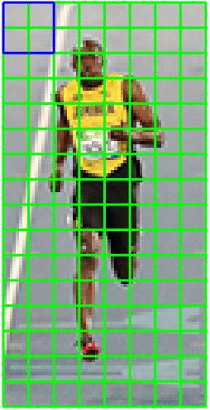
Feature descriptor (HOG)
Segment the image in patches (64x128)
Calculate the gradient (magnitude and angle)
Divide the patch in 8x8 cells
Build the histogram for each cell, using 9 angle bins and the magnitude as the distribution
Normalize the histograms in 16x16 blocks (4 contiguous cells)
Concatenate 4 histograms (36 bins)
Using L2 norm
Reduce lighting dependency.
source: Mallick. learn OpenCV. [2]

Slide 27
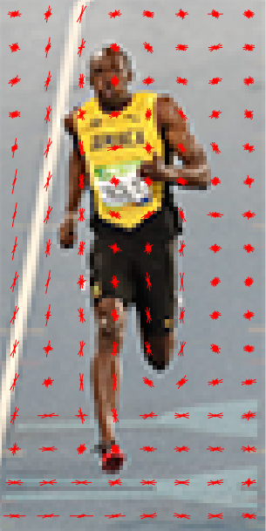
Feature descriptor (HOG)
Segment the image in patches (64x128)
Calculate the gradient (magnitude and angle)
Divide the patch in 8x8 cells
Build the histogram for each cell, using 9 angle bins and the magnitude as the distribution
Normalize the histograms in 16x16 blocks
Concatenate 36-bins vectors (histograms) from each block into a 3780 values.
7 horizontal positions
15 vertical positions
7x15x36 = 3780
source: Mallick. learn OpenCV. [2]

Slide 28
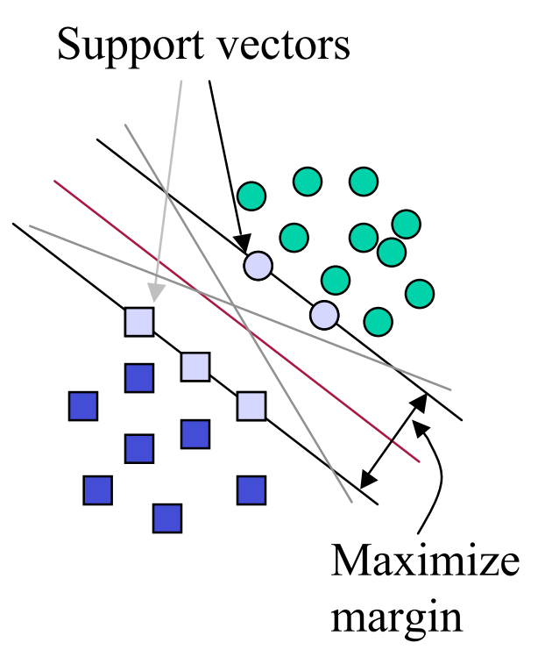
Support Vector Machine (SVM)
Supervised learning method for classification.
Closest points determine the hyperplane. (Support vectors)
Based on the resulting histogram, decide if it is a positive detection.
Trained with the INRIA person dataset.
3600 images
source: R. Berwick. MIT. [3]

Slide 29
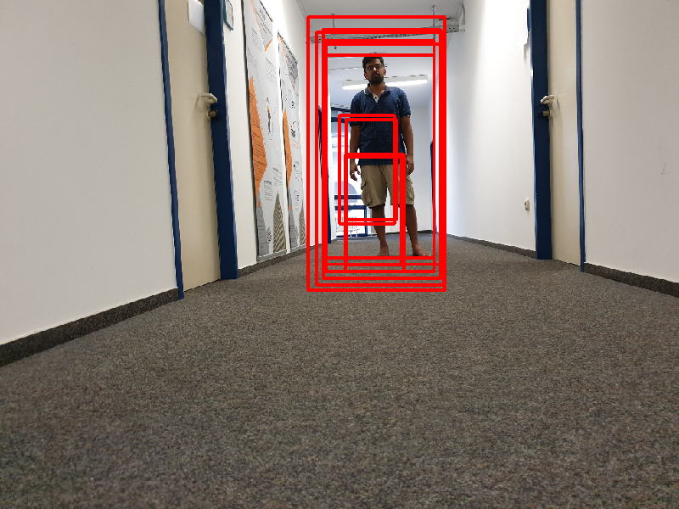
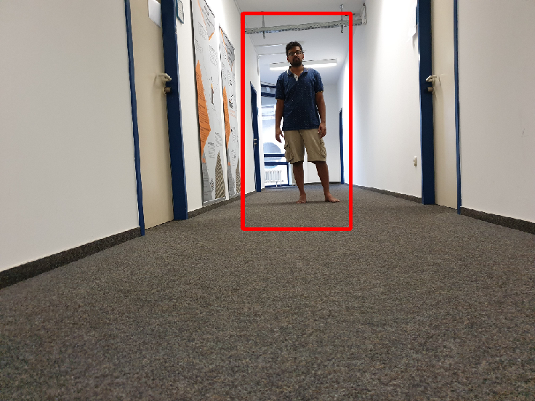
Non maximum suppression (NMS)
Transform many window hypothesis into a single box for each detected pedestrian
Resulting rectangles are the biggest in the overlapping region

Slide 30
Component Description: CameraNano Algorithm: Challenges
Little knowledge about the algorithm.
Initial research and skinny sheep on Virtual Machine.
Image quality and mechanical assembly.
Fine tuning with the final configuration.
No golden parameters for best results and dependence on camera.
Fine tuning on real testing scenario.
Vertical lines false positives.
Line filtering
High variability with light conditions.
Extended testing: different times of the day.

Slide 31
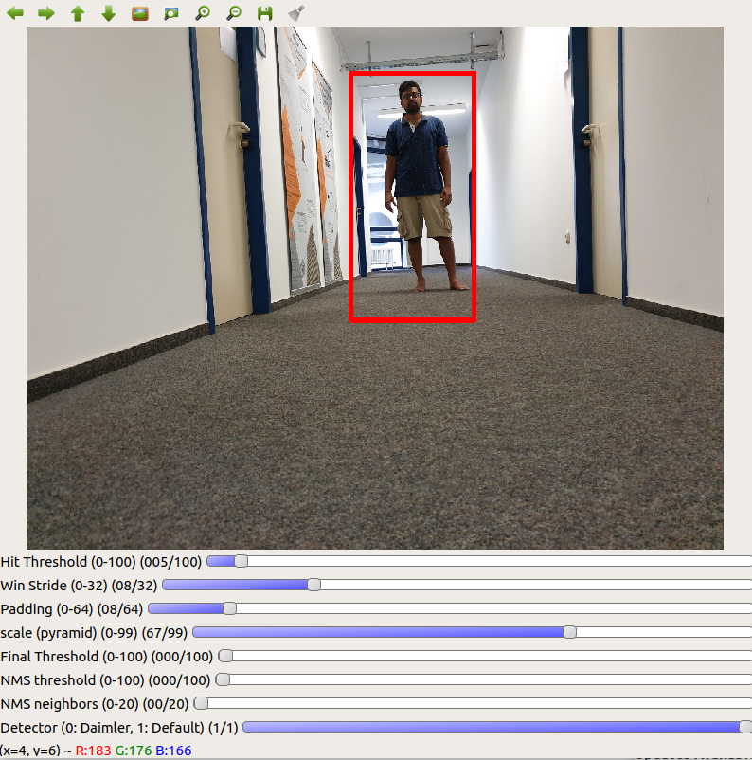
Component Description: CameraNano Algorithm: Skinny sheep
Algorithm implementation with actual framework (openCV) on a virtual machine.
Getting the detection up and running early in the project.
Risk mitigation.
Increasing knowledge before hardware arrived.
GUI for parameter configuration.
Easier and faster tuning and testing.
Evaluating behaviour of the algorithm

Slide 32
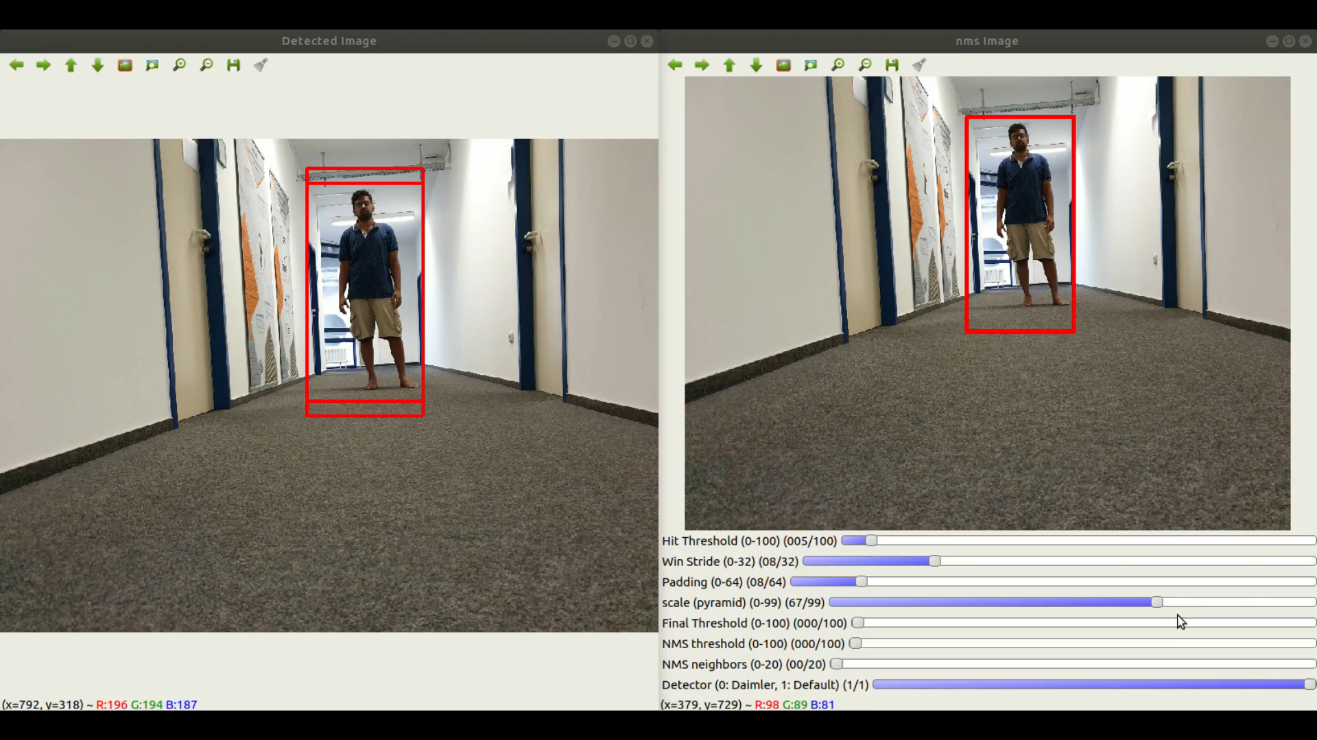
Component Description: CameraNano Algorithm: Skinny sheep

Slide 33
Bibliography
Navneet Dalal, Bill Triggs. Histograms of Oriented Gradients for Human Detection. Cordelia Schmid and Stefano Soatto and Carlo Tomasi. International Conference on Computer Vision
Pattern Recognition (CVPR ’05), Jun 2005, San Diego, United States. IEEE Computer Society, 1, pp.886–893, 2005, <http://ieeexplore.ieee.org/xpls/abs_all.jsp?arnumber=1467360>.
<10.1109/CVPR.2005.177>. <inria-00548512>
Mallick, Satya. “Histogram of oriented gradients”. December 2016. Consulted in: https://www.learnopencv.com/histogram-of-oriented-gradients/
R. Berwick. “An idiot’s guide to Support Vector machines (SVMs)”. MIT. Consulted in: http://web.mit.edu/6.034/wwwbob/svm-notes-long-08.pdf
INRIA Person Dataset. Consulted in: http://pascal.inrialpes.fr/data/human/
Rosebrock, Adrian. HOG detectMultiScale parameters explained. November 2015: pyimagesearch. Consulted in: https://www.pyimagesearch.com/2015/11/16/hog-detectmultiscale-parameters-explained/

Slide 34
Future Scope of Work
Future Scope
Extended features
Multiple pedestrian detection
Multiple object detection – such as Animals, Vehicles, etc.
Multiple cameras for 360 degree field of view
Quality of camera to improve accuracy
Camera image stabilisation
Camera Mounting height, angle
Algorithms to explore
Histogram of Oriented Gradients (HOG)
Scale Invariant Feature Transform (SIFT)
Convolutional Neural Networks (CNNs)

Slide 35
Future Scope of Work
Future Scope cont…
Libraries
Tensor flow
PyTorch
mlpack
Speed improvement
FPGA
GPUs

Slide 36
----ibilities Focus
Quality
Review and Testing
Design and code of every module reviewed in team
Extensive system tests done regularly for detection and feedback taken up for algorithm fine-tuning
Algorithm fine-tuning
Elimination of false positives
Line detected as human issue – Hough algorithm-based tuning
Maintainability and Scalability
LiDAR added as service – helps LiDAR redesign team to easily integrate
Common code framework for Gateway
Nano chosen for higher bandwidth – helps integrate multiple cameras

Slide 37
Lessons Learnt
Team was risk averse – Needed fewer RPI-3 boards
Initially lacked imagination in Camera mounting and mechanical designs
Could have tried benchmarking with 2 different cameras

Slide 38
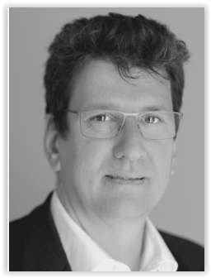
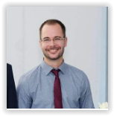
Thank you!
Prof. Dr. Peter Fromm
Course Director
IMSEIT, HDA
Mr. Thomas Barth
Teaching Fellow
HDA

